Slide 1
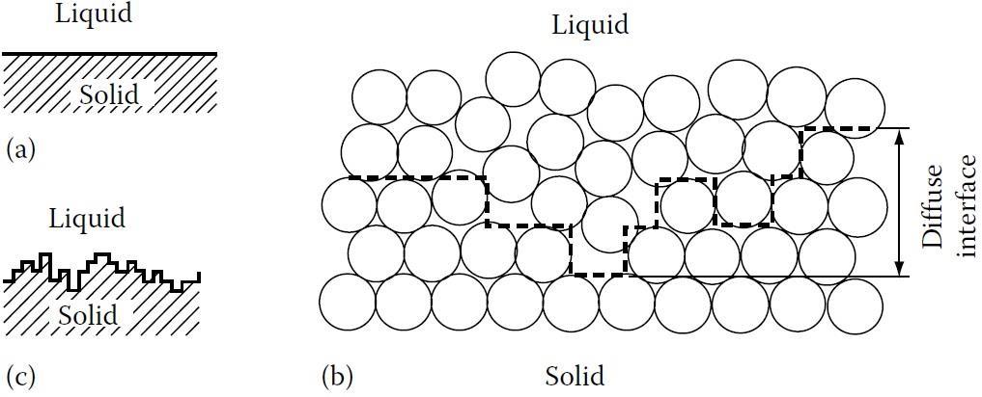

Crystal Growth from the Liquid Phase
Solid/Liquid Interfaces
There are basically two types of atomic structure for solid/liquid interfaces. One is
an atomically flat close-packed interface, (Figure 1-a). In this case the transition
from liquid to solid occurs over a rather narrow transition zone approximately one
atom layer thick. Such interfaces can also be described as smooth, faceted, or
sharp. The other type is an atomically diffuse interface, (Figure 1-b), in which the
transition from liquid to solid occurs over several atom layers. Diffuse interfaces
are also known as rough or non-faceted. The dotted line in (Figure 1-b) is an
attempt to show the rough nature of the interface by dividing the atoms into the
‘solid’ and ‘liquid’. If this is done the schematic representation of (Figure 1-c) can
be used.
Figure 1
Thus there
is a gradual weakening of the interatomic bonds and an increasing
disorder across the interface into the bulk liquid phase; or in thermodynamic terms,
1

Slide 2
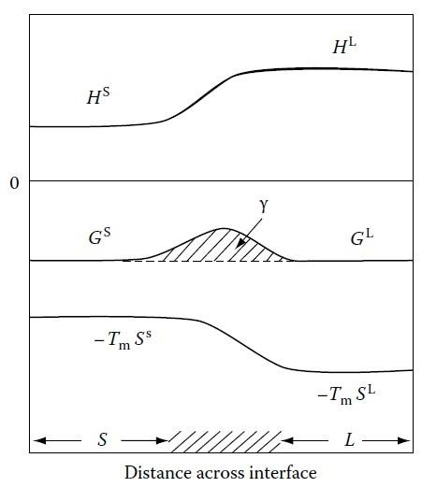
enthalpy and entropy gradually change from bulk solid to bulk liquid values across
the interface as shown in (Figure 2). When the solid and liquid are in equilibrium
(at T_{m}) the high enthalpy of the liquid is balanced by high entropy so that both
phases have the same free energy. In the interface, however,
the
balance
is
disturbed thereby giving rise to an excess free energy,
γSolid-Liquid.
Figure 2
The type of structure chosen by a particular system will be that which
minimizes
the interfacial free energy. According to a simple theory developed by Jackson: the
optimum atomic arrangement depends mainly on the latent heat of fusion (L_{f})
relative to the melting temperature (T_{m}). This theory predicts that there is a critical
value of (L_{f} /T_{m} ≈ 4R) above which the interface should be flat and below which it
should be diffuse. Most metals have L_{f} /T_{m} ≈ R and are therefore predicted to have
rough interfaces, (R = 8.314 J/mole. K). On the other hand some intermetallic
compounds and elements such as Si, Ge, Sb as well as most non-metals have high
2

Slide 3
values of (Lf /Tm) and generally have flat closepacked interfaces. If the model is
applied to solid/vapour interfaces L_{S} (the heat of sublimation) should be used
instead of L_{f} and then flat surfaces are predicted even for metals, in agreement with
observations.
An atomically rough or diffuse interface associated with metallic systems, and an
atomically flat or sharply defined interface often associated with non-metals.
Because of the differences in atomic structure these two types of interface migrate
in quite different ways. Rough interfaces migrate by a continuous growth process
while flat interfaces migrate by a lateral growth process involving ledges.
Continuous Growth
The solidification of metals is usually a diffusion controlled process. For pure
metals growth occurs at a rate controlled by heat conduction (diffusion) whereas alloy solidification is controlled by solute diffusion.
In diffuse interfaces, it can be assumed that atoms can be received at any site on
the solid surface. For this reason it is known as continuous growth. Such a mode of
growth is reasonable because the interface is disordered and atoms arriving at
random positions on the solid will not significantly disrupt the equilibrium
configuration of the interface. The situation is, however, more complex when the
equilibrium interface structure is atomically smooth as in the case of many non-
metals.
3

Slide 4
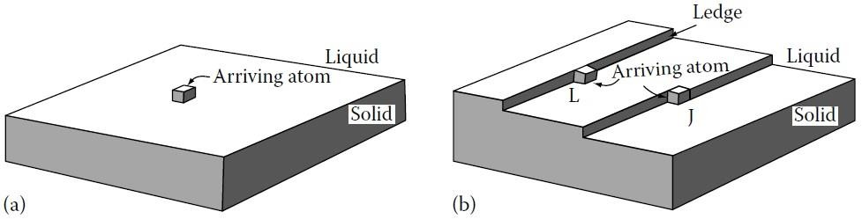
Lateral Growth
Materials with high entropy of melting prefer to form atomically smooth, close-
packed interfaces. For this type of interface the minimum free energy also
corresponds to the minimum internal energy. If a single atom leaves the liquid and
attaches itself to the flat solid surface, (Figure 3-a), it can be seen that the
interfacial energy will increase with increasing of interfaces. There is therefore
little probability of the atom remaining attached to the solid and it is likely to jump
back into the liquid. If the interface contains ledges, (Figure 3-b), ‘liquid’ atoms
will be able to join the ledges with a much lower resulting increase in interfacial
energy. If the ledge contains a jog, J, atoms from the liquid can join the solid
without any increase in the interfacial energy. Consequently the probability of an
atom remaining attached to the solid at these positions is much greater than for an
atom joining a facet. Smooth solid/liquid interfaces
advance by the lateral growth of ledges.
can
therefore
be
expected
to
Figure 3
Heat Flow and Interface Stability:
In pure metals solidification is controlled by
the rate at
which the latent heat
of
solidification can be conducted away from the solid/liquid interface. Conduction
can take place either through the solid or the liquid depending on the temperature
4

Slide 5
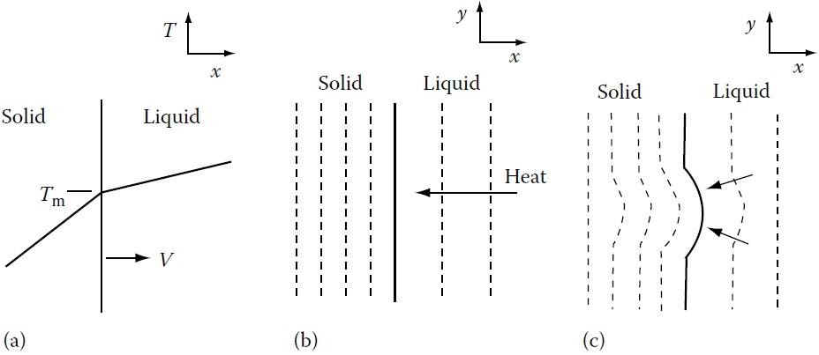
gradients at the interface. Consider for example solid growing at a velocity (v) with
a planar interface into a superheated liquid (Figure 4-a). The heat flow away from
the interface through the solid must balance that from the liquid plus the latent heat
generated at the interface, i.e.
Where K is the thermal conductivity,
is the temperature gradient (dT/dx), the
subscripts S and L stand for solid and liquid, v is the rate of growth of the solid,
and L_{f} is the latent heat of fusion per unit volume.
When a solid grows into a superheated liquid, a planar solid/liquid interface is
stable. This can be shown as follows. Suppose that as a result of a local increase in
v a small protrusion forms at the interface, (Figure 4-c). Therefore the temperature
gradient in the liquid ahead of the nodule will increase while that in the solid
decreases. Consequently more heat will be conducted into the protruding solid and
less away so that the growth rate will decrease below that of the planar regions and
the protrusion will disappear.
Figure 4
5

Slide 6
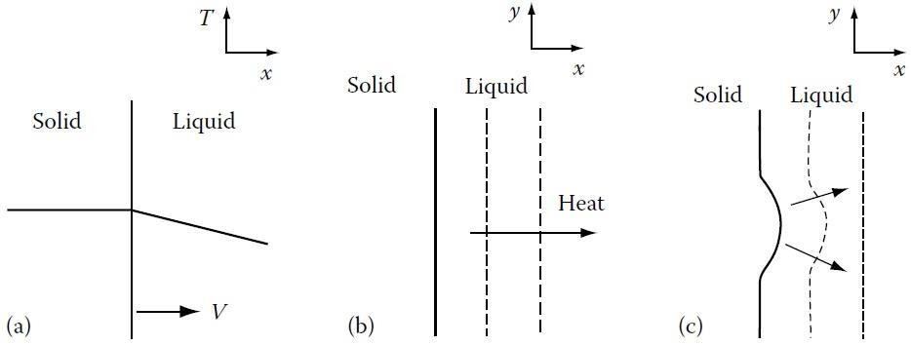
The situation is, however, different for a solid growing into supercooled liquid,
Figure 5. If a protrusion forms on the solid in this case the negative temperature
gradient in the liquid becomes even more negative. Therefore heat is removed
more effectively from the tip of the protrusion than from the surrounding regions
allowing it to grow preferentially. A solid/liquid
supercooled liquid is thus inherently unstable.
interface
advancing
into
Figure 5
Heat conduction through the solid as depicted
in Figure
4, arises when
solidification takes place from mould walls which are cooler than the melt. Heat
flow into the liquid, however, can only arise if the liquid is supercooled below T_{m}.
Such a situation can arise at the beginning of solidification if nucleation occurs at
impurity particles in the bulk of the liquid. Since a certain supercooling is required
before nucleation can occur, the first solid particles will grow into supercooled
liquid and the latent heat of solidification will be conducted away into the liquid.
An originally spherical solid particle will therefore develop arms in many
6

Slide 7
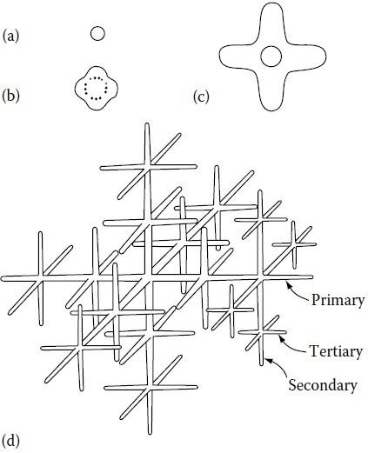
directions as shown in Figure 6. As the primary arms elongate their surfaces will
also become unstable and break up into secondary and even tertiary arms. This
shape of solid is known as a dendrite. Dendrite comes from the Greek for tree.
Dendrites in pure metals are usually called thermal dendrites to distinguish them
from dendrites in alloys. It is found experimentally that the dendrite arms are
always in certain crystallographic directions: e.g. 〈100〉 in cubic metals, and 〈1100〉
in hcp metals.
Figure 6
7

Slide 8
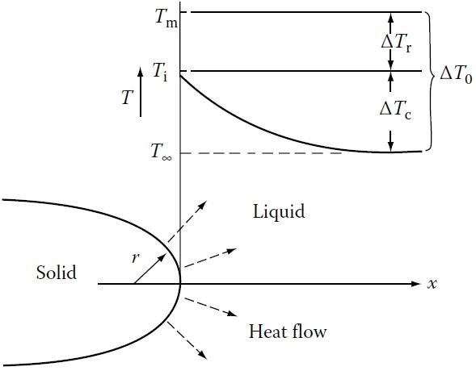
Figure 7
At the tip of a growing dendrite the situation is different from that of a planar
interface because heat can be conducted away from the tip in three dimensions. We
assume the solid is isothermal (
), the (negative) temperature gradient is
approximately given by (ΔT_{c} / r) where ΔTc is the difference between the
interface temperature (T_{i}) and the temperature of the supercooled liquid far from
the dendrite (T∞) as shown in Figure 8, so
Thus for a given ΔT_{c} rapid growth will be favoured by small values of r due to the
increasing effectiveness of heat conduction as r diminishes. As a result of the
Gibbs–Thomson effect equilibrium across a curved interface occurs at an
undercooling ΔT_{r} below T_{m} given by
8

Slide 9
The minimum possible radius of curvature of the tip is when ΔT_{r} equals the total
undercooling ΔT0 = Tm − T∞. This is just the critical nucleus radius r* given by
. Therefore in general ΔT_{r} is given by (ΔT₀ r*/r). Finally since
ΔT₀ = ΔT_{c} + ΔT_{r} , so
It can thus be seen that the tip velocity tends to zero as r → r* and as r → ∞. The
maximum velocity is obtained when r = 2r*.
Growth Directions in Various Crystal Structures:
FCC <100>
BCC <100>
HCP <10-10>
BCT (tin) <110>
In cubic crystals the <100> dendrite arm growth direction leads to the secondary
arms being perpendicular to the primary arms. Also, the tertiary arms are perpendicular to the secondary arms.
The movement of a boundary separating liquid from solid, under the influence of a
temperature gradient normal to the boundary, is the result of two different atomic movements.
Atoms leave the liquid and join the solid = rate of attachment
Atoms leave the solid and join the liquid = rate of detachment
9

Slide 10
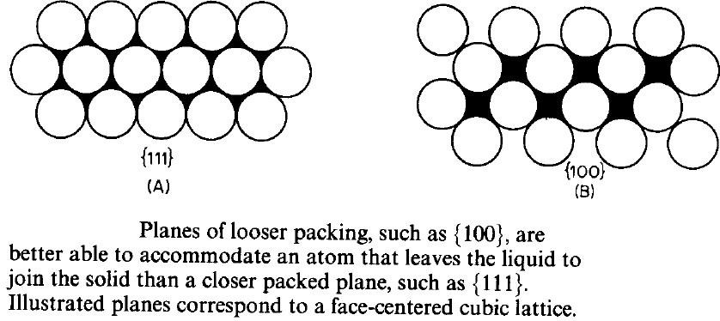
Planes of looser atomic packing can better accommodate an atom that leaves the
liquid. Where a growing crystal will assume faces that represent slow growing planes.
The shape of a growing crystal can be affected by the fact that different crystal
faces have different growth rates. Close-packed low-energy faces
tend
to grow
growing
slower and,
crystallite.
as
a
result,
they
are
the
ones
that
are
mostly
present
in
a
Figure 8
10

Slide 11
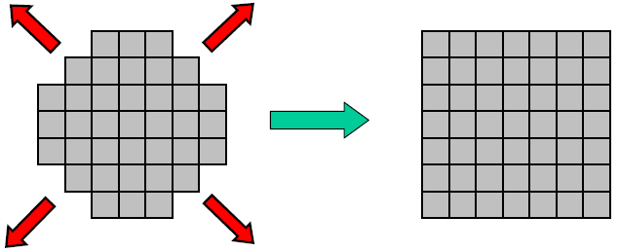
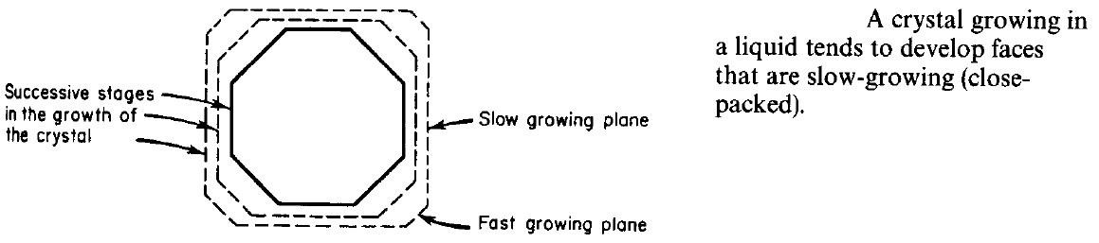
Figure 9
Total rate of a phase transformation induced by cooling is a product of the
nucleation rate (driving force increases with undercooling but diffusion needed for
atomic rearrangement slows down with T decrease) and growth rate (diffusion
controlled - slows down with T decrease) Figure 10.
At high T (close to Tm): low nucleation and high growth rates → coarse
microstructure with large grains.
At low T (strong undercooling): high nucleation and low growth rates → fine
structure with small grains.
11

Slide 12
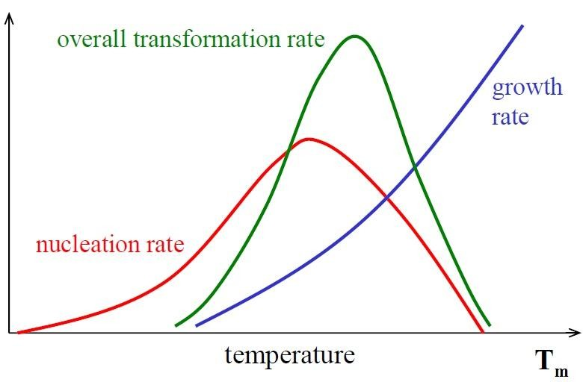

Figure 10
12

Slide 13
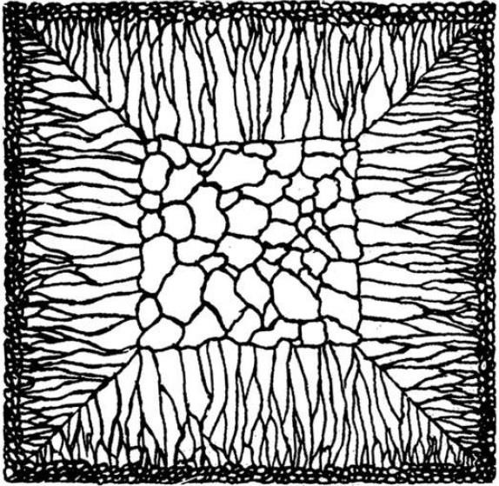
Grains Structure of Ingots and Castings
Most engineering alloys begin by casting process. If the as-cast pieces are
permitted to retain their shape afterwards, or are reshaped by machining, they are called castings. If they are later to be worked, e.g. by rolling, extrusion or forging, the pieces are called ingots. In either case the principles of solidification are the same.
Generally speaking three different zones can be distinguished in solidified alloy
ingots (Figure 11). These zones are (i) chill zone of equiaxed crystals,
columnar zone of elongated grains, and (iii) a central equiaxed zone.
(ii)
a
Figure 11
Chill Zone:
During pouring the liquid in contact with the cold mould wall is rapidly
cooled
below the liquidus temperature. Many solid nuclei then form on the mould wall
and begin to grow into the liquid, (Figure 12). As the mould wall warms up it is possible for many of these solidified crystals to break away from the wall under the
13

Slide 14
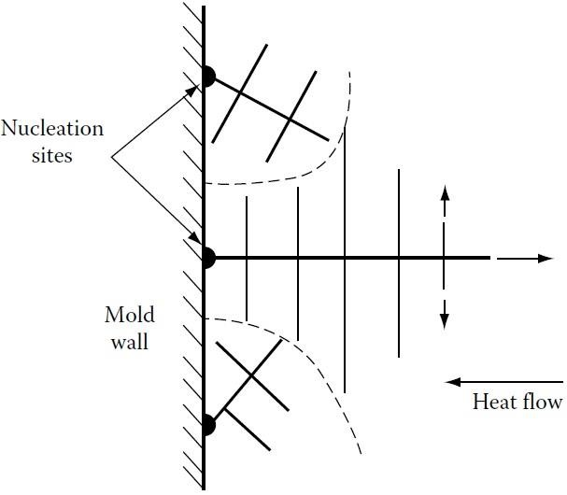
influence of the turbulent melt. If the pouring temperature is low the whole of the
liquid will be rapidly cooled below the liquidus temperature and the crystals swept
into the melt may be able to continue to grow. This is known as ‘big-bang’
nucleation since the liquid is immediately filled with a myriad of crystals. This
produces an entirely equiaxed ingot structure, i.e. no columnar zone forms, this
also can be done by adding seeds or inoculants which are a solid small particles
added to molten metal in the mold. If the pouring temperature is high, on the other
hand, the liquid in the centre of the ingot will remain above the liquidus
temperature for a long time and consequently the majority of crystals soon remelt
after breaking away from the mould wall. Only those crystals remaining close to
the wall will be able to grow to form the chill zone.
Figure 12
Columnar Zone
Very soon after pouring the temperature gradient at the mould walls decreases and
the crystals in the chill zone grow dendritically in certain crystallographic directions, e.g. <100> in the case of cubic metals. Those crystals with a <100>
14

Slide 15
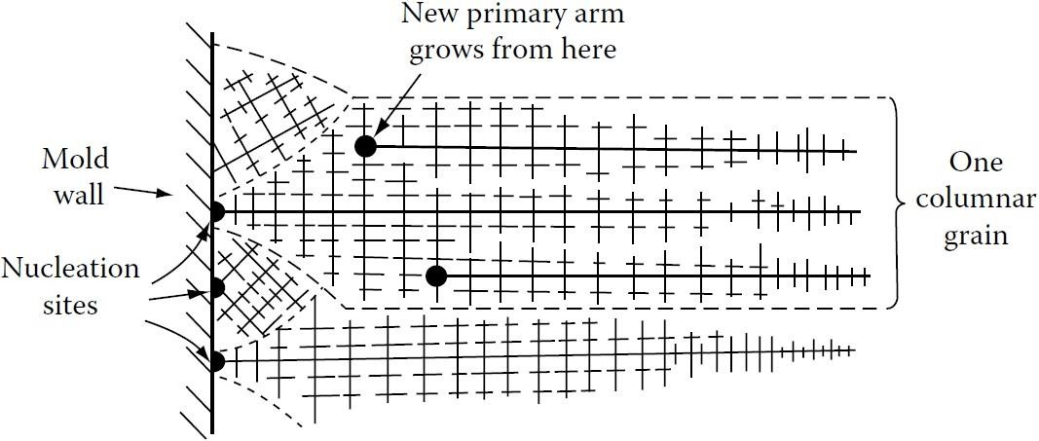

direction close to the direction of heat flow, i.e. perpendicular to the mould walls,
grow fastest and are able to outgrow less favourably oriented neighbours (Figure
13). This leads to the formation of the columnar grains all with <100> almost
parallel to the column axis. Note that each columnar crystal may contain primary
dendrite arms (if it is an alloy). As the diameter of these grains increases additional
primary dendrite arms appear by a mechanism in which some tertiary arms grow
ahead of their neighbours as shown in the figure.
Figure 13
Equiaxed Zone
The equiaxed zone consists of equiaxed grains randomly oriented in the centre of
the ingot. An important origin of these grains is thought to be melted-off dendrite
side-arms. It can be seen that the side arms are narrowest at their roots. Therefore,
if the temperature around the dendrite increases after it has formed, it will begin to
melt and may become detached from the main stem. Provided the temperature falls
again before the arm completely disappears it can then act as a ‘seed’ for a new
dendrite. An effective source of suitable temperature pulses is provided by the
15

Slide 16
turbulent convection currents in the liquid brought about by the temperature
differences across the remaining melt. Convection currents also provide a means of
carrying the melted-off arms away to where they can develop uninhibited into
equiaxed dendrites. If convection is reduced, fewer seed crystals are created
causing a larger final grain size and a greater preponderance of columnar grains.
Shrinkage Effects
Most metals shrink on solidification and this has important consequences for the
final ingot structure. In pure metals, and also in narrow freezing range alloys
(where the mushy zone is also narrow); as the outer shell of solid thickens the level
of the remaining liquid continually decreases until finally when solidification is
complete the ingot contains a deep central cavity or pipe. In alloys with a wide
freezing range the mushy zone can occupy the whole of the ingot. In this case no
central pipe is formed. Instead the liquid level gradually falls across the width of
the ingot as liquid flows down to compensate for the shrinkage of the dendrites.
However, as the inter-dendritic channels close up, this liquid flow is inhibited so
that the last pools of liquid to solidify leave small voids or porosities.
16

Slide 17
Segregation in Ingots and Castings
Two types of segregation can be distinguished in solidified structures. There is
macrosegregation, i.e. composition changes over distances comparable to the size of the specimen, and there is microsegregation that occurs on the scale of the secondary dendrite arm spacing.
There are four important factors that can lead to macrosegregation in ingots. These
are: (i) shrinkage due to solidification and thermal contraction; (ii) density
differences in the inter-dendritic liquid; (iii) density differences between the solid
and liquid; and (iv) convection currents driven by temperature-induced density
differences in the liquid. All of these factors can induce macrosegregation by
causing mass flow over large distances during solidification.
Shrinkage effects can give rise to what is known as inverse segregation. As the
columnar dendrites thicken solute-rich liquid [assuming (partitioning constant) k <
1] must flow back between the dendrites to compensate for shrinkage and this
raises the solute content of the outer parts of the ingot relative to the centre. The
effect is particularly marked in alloys with a wide freezing range, e.g. Al–Cu and
Cu–Sn alloys.
Interdendritic liquid flow can also be induced by gravity effects. For example
during the solidification of Al–Cu alloys the copper rejected into the liquid raises its density and causes it to sink. The effect can be reinforced by convection currents driven by temperature differences in the ingot.
Gravity effects can also be observed when equiaxed crystals are forming. The solid
is usually denser than the liquid and sinks carrying with it less solute than the bulk
composition (assuming k < 1). This can, therefore, lead to a region of negative
segregation near the bottom of the ingot.
17

Slide 18
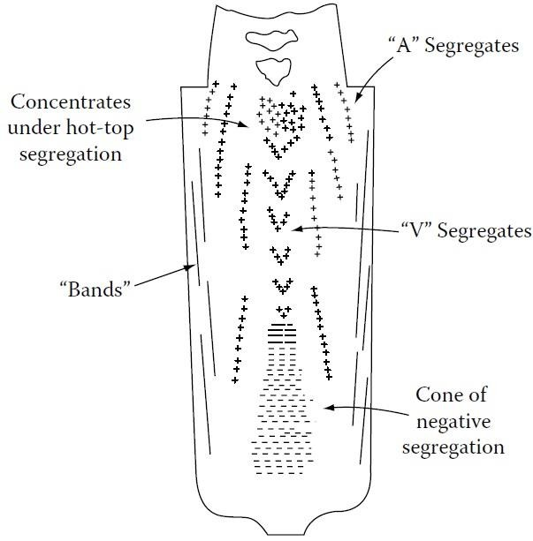
The combination of all the above effects can lead to complex patterns of
macrosegregation. Figure 14 for example illustrates the segregation patterns found in large steel ingots.
In general segregation is undesirable as it has marked deleterious effects on
mechanical properties. The effects of microsegregation can be mitigated by subsequent homogenization heat treatment, but diffusion in the solid is far too slow
to be able to remove macrosegregation
control of the solidification process.
which
can
only
be
combated
by
good
Figure 14
18

